Slide 1
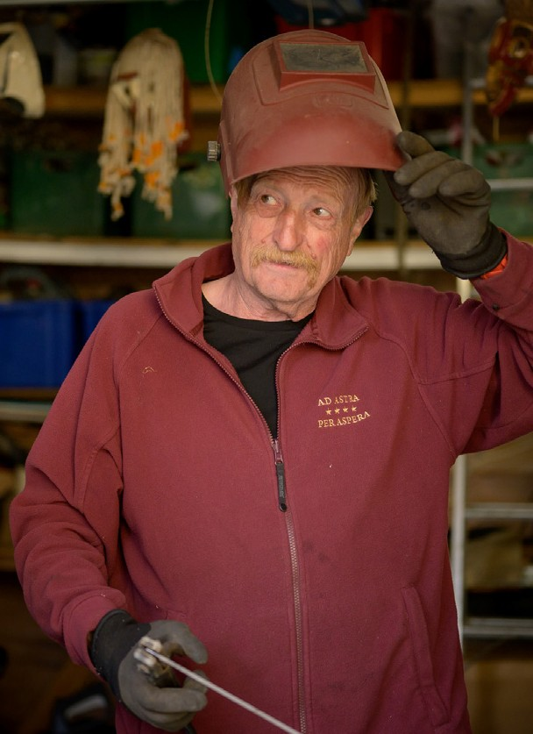
Becoming an age-friendly employer
What we’re doing and why it matters.

Slide 2
Why being age-friendly matters
By 2030 more than half the workforce will be over 50.
The current skills and labour shortage is costing the UK economy £6.6bn. Workers in their 50s, 60s and beyond are the solutions to this shortage.
Ageism is real — age is a protected characteristic, and action needs to be taken by everyone.
Older workers bring a huge amount of value to our organisation through their experience, perspective and skills.
Multigenerational workforces drive productivity and innovation.

Slide 3
The Pledge
1
As an Age-friendly Employer, we have..
Named our senior sponsor for age-inclusion in our workforce
1
2
Ensured age is specifically named within our Equality, Diversity and Inclusion policies
Notes:
We're just going to take a minute or two to quickly recap the action that we're asking you to take as pledge signers. You'll have named a senior level sponsor when you signed the pledge. In your communications, we'd also love for you to share the pledge logo on your website, careers pages and any recruitment materials.
We also as that age is specifically named in your EDI policy, and that you take at least one action a year to become a more age-friendly employer, from one of the five areas of our Framework.
Its this last section under Point 3 that we want every organisation to review, discuss and to report back on with us – to take action in at least one area each year from signing. Again, these are:
Creating an Age Friendly Culture
Hiring Age Positively
Being Flexible About Flexible Working
Encouraging Career development at all ages and finally
Ensuring everyone has the health support they need
The best resource here to support you is the action framework at the employer pledge webpage
- https://ageing-better.org.uk/age-friendly-employer-action-framework.
We will show an example and a link to this framework before the end of this slide deck.

Slide 4
The Pledge we are taking
1
We will be taking action to improve the recruitment, retention and development of workers over 50 from one of the following areas:
3
Create an age-friendly culture
Hire age-positively
Be flexible about flexible working
Encourage career development at all ages
Ensure everyone has the health support they need
We will commit to take action in at least one area every year and will report back on our activities and achievements annually.
Notes:
We're just going to take a minute or two to quickly recap the action that we're asking you to take as pledge signers. You'll have named a senior level sponsor when you signed the pledge. In your communications, we'd also love for you to share the pledge logo on your website, careers pages and any recruitment materials.
We also as that age is specifically named in your EDI policy, and that you take at least one action a year to become a more age-friendly employer, from one of the five areas of our Framework.
Its this last section under Point 3 that we want every organisation to review, discuss and to report back on with us – to take action in at least one area each year from signing. Again, these are:
Creating an Age Friendly Culture
Hiring Age Positively
Being Flexible About Flexible Working
Encouraging Career development at all ages and finally
Ensuring everyone has the health support they need
The best resource here to support you is the action framework at the employer pledge webpage
- https://ageing-better.org.uk/age-friendly-employer-action-framework.
We will show an example and a link to this framework before the end of this slide deck.

Slide 5
What we’re doing — next steps
Edit this slide so it is relevant to your organisation. You could:
List actions you intend to take in the short- to medium-term to become more age-friendly.
Mention longer-term goals if relevant.
If you have already started to take action, list it here.
Talk about ways that people can get involved with supporting this work.

Slide 6
What you can do now
Challenge ageism when you see it — don't be a bystander.
Educate yourself about ageism. Read about the Age Without Limits campaign
Normalise the conversation in the workplace to encourage an open dialogue.
Talk to us about how you can get involved and support this work.

Slide 7
Any questions?
If you have any questions, get in touch with: Add contact details here

